Slide 1

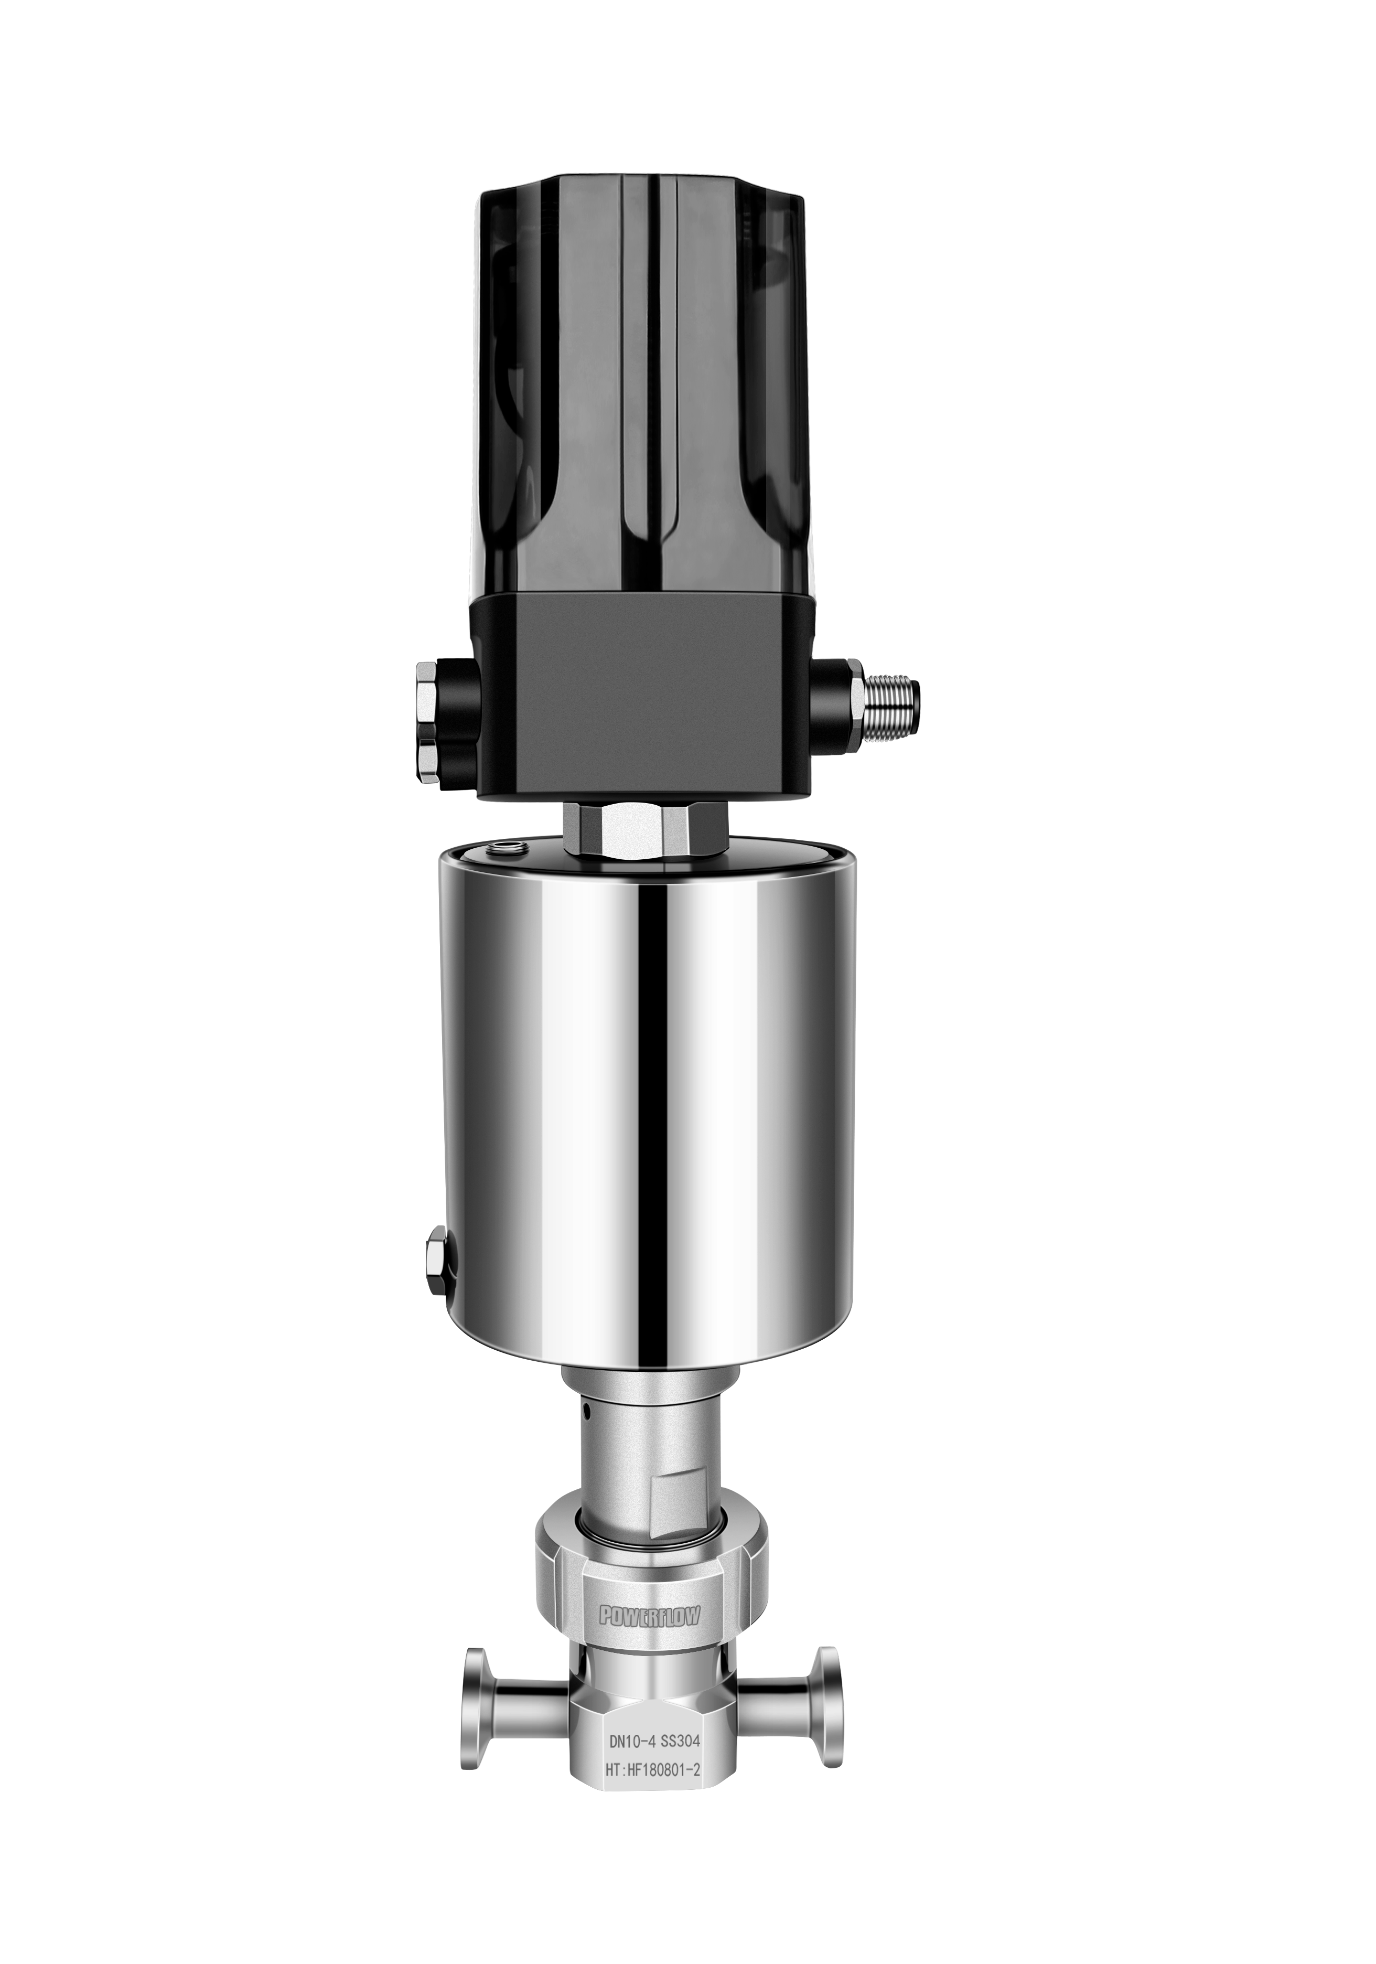
Micro Control Valve
3100 series
Xfluid 3100 series micro control valve is designed to handle small flow rate liquid and air precisely with maximum 180℃ temperature.
DN2.8-DN8
Max Pressure: 25Bar
Temperature range:0℃-180℃
Kv range from 0.007-1.19m³/h
Body material: SS304
Sealing material: PTFE
Combined with POWERFLOW 1500/1600/1880 valve positioner
Minimum control dead zone: 1%

Slide 2

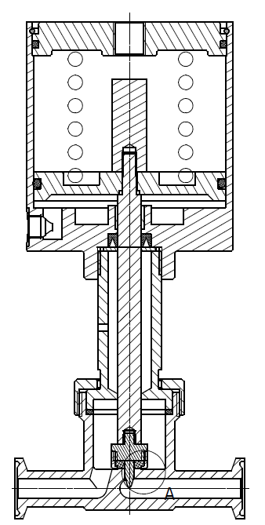
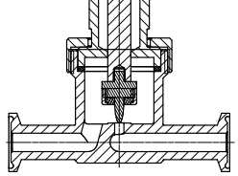
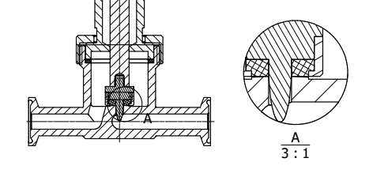
Valve Structure
Flow Direction
Fully Opened
Fully Closed

Slide 3
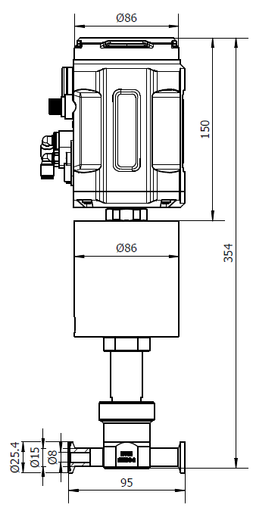
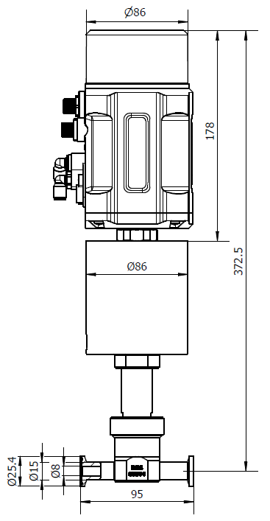
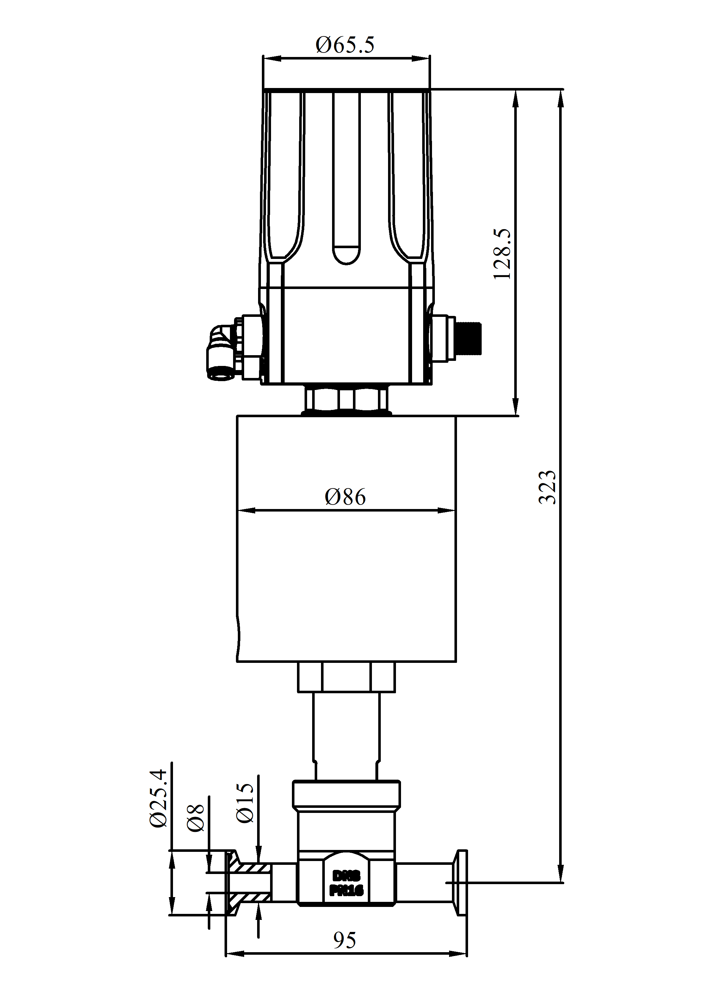
Valve Dimension.
Combined with 1500 series positioner
Combined with1600 series positioner
Combined with1880 series positioner

Slide 4
Kv Data
Type selection | 10% | 20% | 30% | 40% | 50% | 60% | 70% | 80% | 90% | 100%
3128 (DN2.8) | 0.007 | 0.013 | 0.02 | 0.024 | 0.035 | 0.04 | 0.043 | 0.06 | 0.079 | 0.18
3135 (DN3.5) | 0.034 | 0.042 | 0.048 | 0.064 | 0.074 | 0.088 | 0.1 | 0.12 | 0.2 | 0.26
3140 (DN4) | 0.06 | 0.068 | 0.088 | 0.1 | 0.12 | 0.13 | 0.15 | 0.19 | 0.35 | 0.43
3160 (DN6) | 0.04 | 0.063 | 0.093 | 0.11 | 0.143 | 0.18 | 0.234 | 0.38 | 0.6 | 0.72
3180 (DN8) | 0.25 | 0.32 | 0.44 | 0.52 | 0.65 | 0.77 | 0.92 | 1.06 | 1.16 | 1.19

Slide 5
3100系列微小流量调节阀
Xfluid 3100 系列调节阀是专为精确处理小流量的流体介质所设计的，最高介质温度可达180℃。
DN2.8-DN8
管道压力: Max 25Bar
介质温度: 0℃-180℃
Kv值范围: 0.007-1.19m³/h
阀体材质: SS304
密封材质: PTFE
可与POWERFLOW 1500/1600/1880系列定位器搭配使用
最小控制死区:1%

Slide 6
阀门结构
介质流向
全开状态
全闭状态

Slide 7
机械尺寸
与1500系列定位器匹配
与1600系列定位器匹配
与1880系列定位器匹配

Slide 8
Kv值数据
选型 | 10% | 20% | 30% | 40% | 50% | 60% | 70% | 80% | 90% | 100%
3128 (DN2.8) | 0.007 | 0.013 | 0.02 | 0.024 | 0.035 | 0.04 | 0.043 | 0.06 | 0.079 | 0.18
3135 (DN3.5) | 0.034 | 0.042 | 0.048 | 0.064 | 0.074 | 0.088 | 0.1 | 0.12 | 0.2 | 0.26
3140 (DN4) | 0.06 | 0.068 | 0.088 | 0.1 | 0.12 | 0.13 | 0.15 | 0.19 | 0.35 | 0.43
3160 (DN6) | 0.04 | 0.063 | 0.093 | 0.11 | 0.143 | 0.18 | 0.234 | 0.38 | 0.6 | 0.72
3180 (DN8) | 0.25 | 0.32 | 0.44 | 0.52 | 0.65 | 0.77 | 0.92 | 1.06 | 1.16 | 1.19

